Slide 1

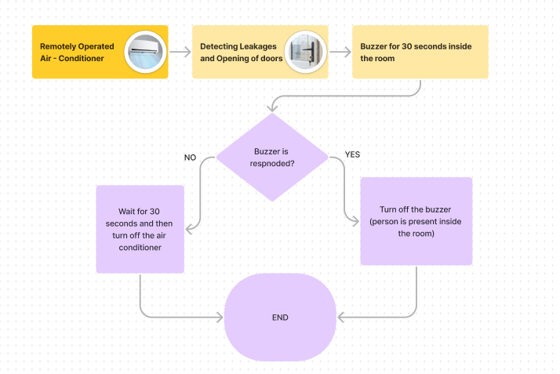
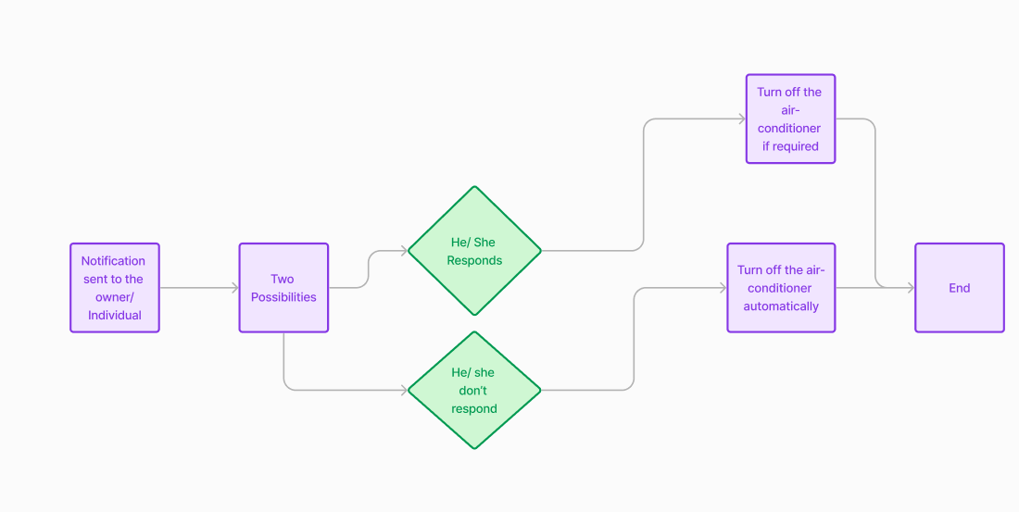
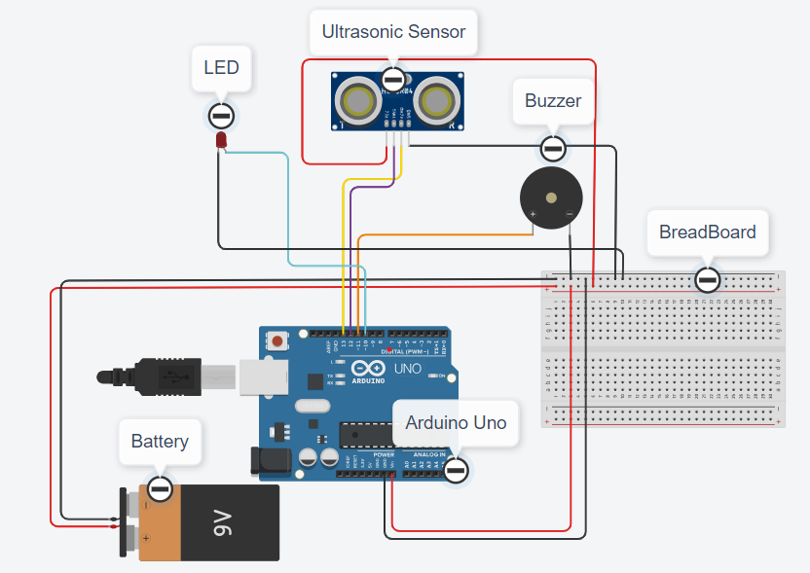
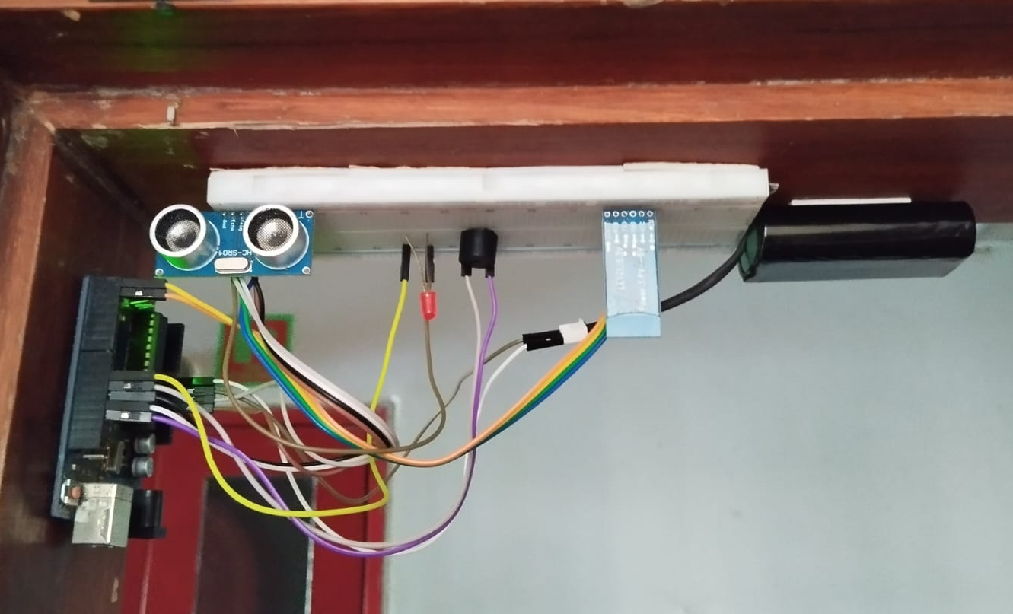
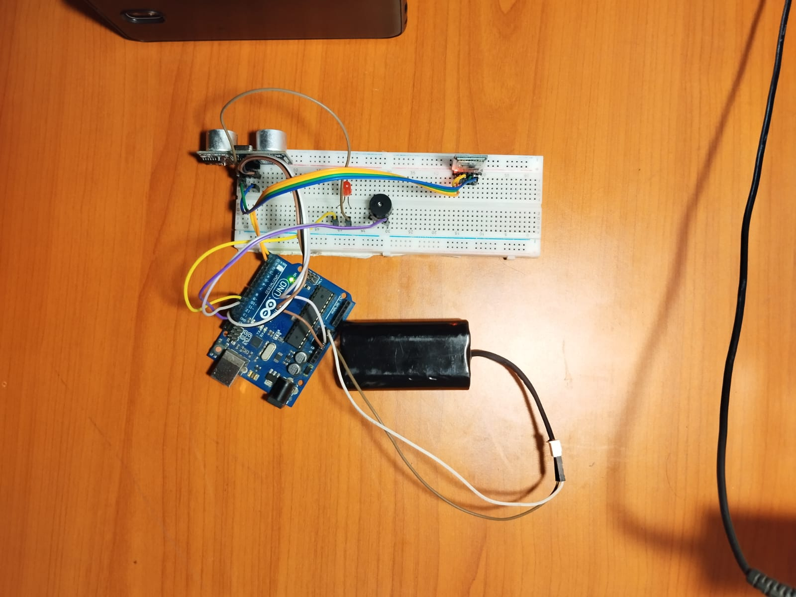
Energy-Saving Room Monitoring System: Detecting and Alerting for Air Leakage of Open Doors
Bishal Kumar Sahani, Uday Verma
^{3rd Year, B. Tech (2021-2025)}
Department of Mechanical Engineering, IIT Bhilai, Chhattisgarh, India
OBJECTIVES
PROJECT DETAIL/METHODOLOGY/RESULTS
Developing a system that detects leakages in rooms by either door or windows.
Implementing sensors to detect open doors or windows, ensuring real-time tracking of door and windows status.
Implementing alert mechanisms to notify the individuals in real time when leakages are detected.
1st Methodology (Hardware Implementation) -
INTRODUCTION
In the contemporary context, there is a substantial utilization of energy dedicated to cooling buildings and maintaining optimal indoor environments.
However, the operation of air conditioning systems can result in considerable energy wastage, primarily when inefficiencies such as faulty vents or room leakages are present.
These inefficiencies contribute to the escape of cooled air, thereby necessitating higher energy consumption to sustain desired temperature settings.
2nd Methodology (Software Implementation) -
PROBLEM DEFINITION
FINDINGS & CONCLUSIONS
The primary problem is to identify and monitor leakages and open doors in rooms to reduce energy consumption and improve energy efficiency.
The central challenge revolves around continuously identifying and monitoring leaks and open points like doors within rooms.
Also, integrating sensor data and promptly alert users about the opening of doors, enhancing awareness and control over energy usage.
Identification of Inefficiencies
Real-time Alerting
Energy Savings
Occupant Comfort
Effective Energy Management
FUTURE WORK/POTENTIAL APPLICATIONS
Applications in cars, houses, etc.
Integration with other sensors to monitor wide range of data
Smart Building Automation and Energy Harvesting Solutions
Data-driven Insights
ME413: REFRIGERATION AND AIR-CONDITIONING
(Course Instructor: Dr. Udayraj)

